Slide 1

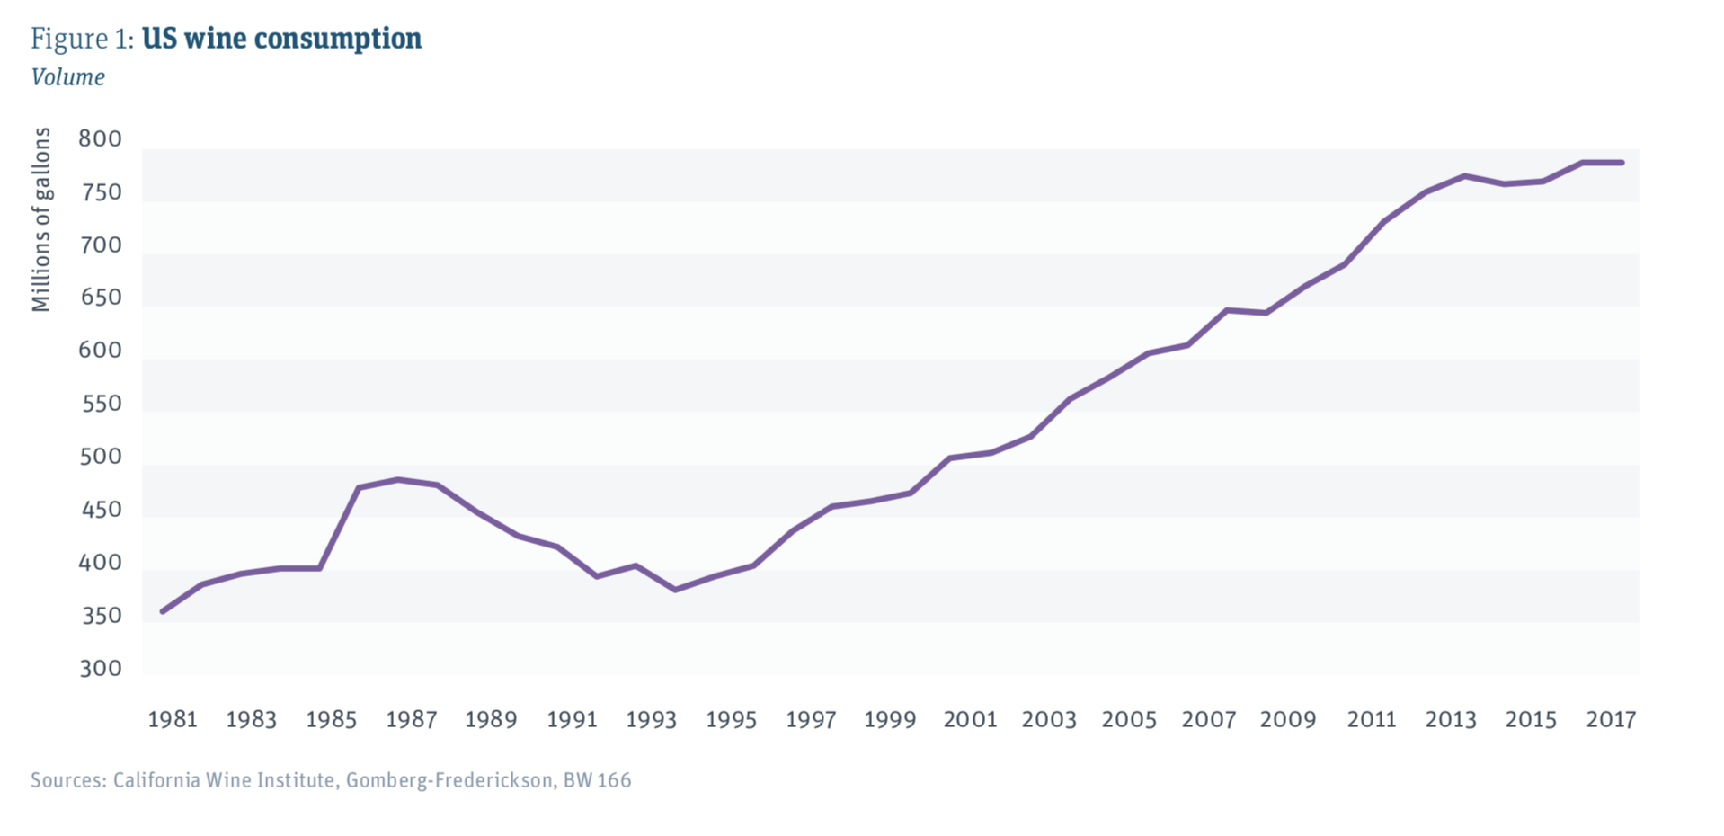
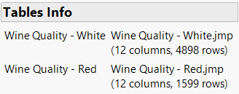
Using JMP® To Analyze Wine Quality
Yongxin Cui Tianhao Zhao & Xinyin Miao
MS Students(Business Analytics and Project Management) , University of Connecticut
Why Wine？
Data Source
Over the past few decades, the consumption of wine increased rapidly.
The Data derived from UCI Machine Learning Repository
Consumers are paying more and more attention to drinking good wine.
Two Datasets:
White Wine & Red Wine
Wine Merchants pursue “high quality” wines that satisfy the discerning palate of the general public.
White Wine: 4898 Rows
Red Wine: 1599 rows

Slide 2
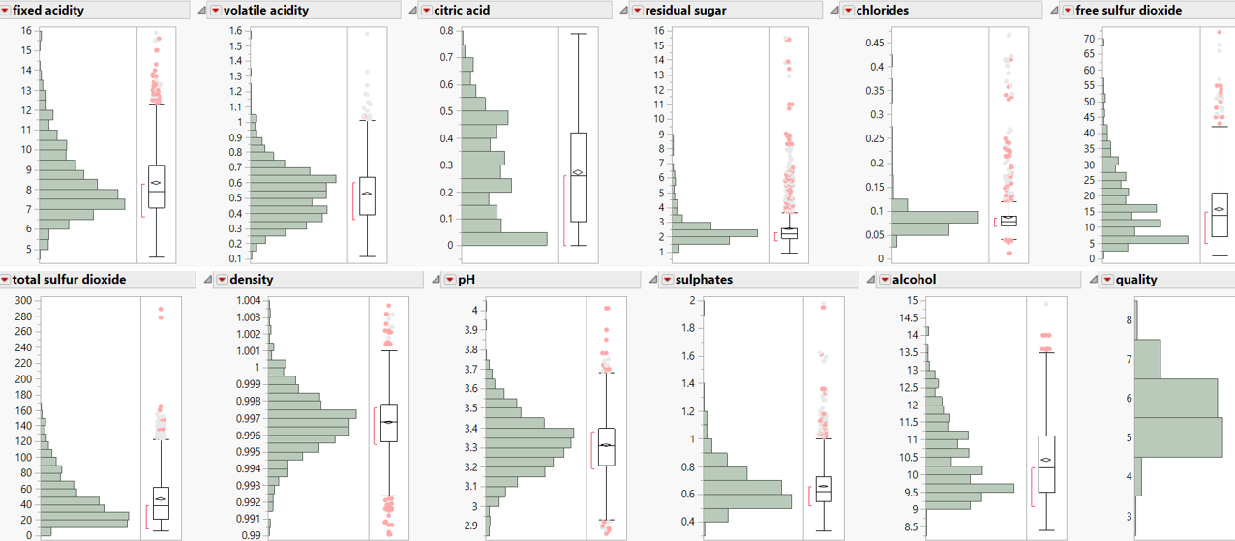
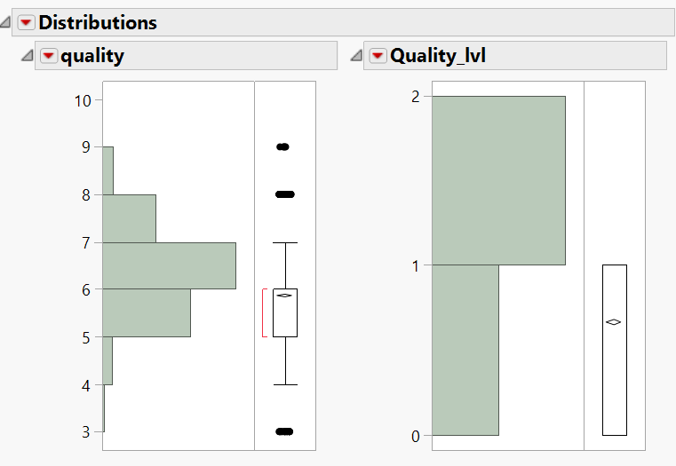
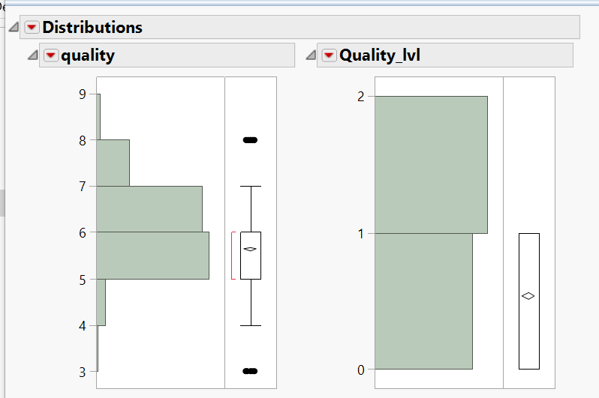
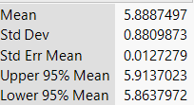
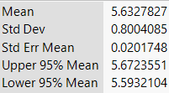
DATA DESCRIPTION
DATA PREPROCESSING
MODEL COMPARISON
MODEL INTERPRETION
RECOMMADATION
Independent Variables:
The Distribution of Variables of Red Wine
PH
Alcohol
Density
Sulphates
Chlorides
Free Sulfur Dioxide
Total Sulfur Dioxide
Residual Sugar
Fixed Acidity
Volatile Acidity
Citric Acidity
Target Variable - Quality
The subjective assessment from Sommelier
From 3 to 9, the higher, the greater the quality
Transformed to Quality level
The Distribution of Target Variable
White Wine
Red Wine
Why Transform?
The prediction could lead to unrealistic results (quality greater than 9 or less than 3)
Median Value of Quality in both dataset is 6.
Transform Result
High Quality with score greater or equal to 6
Low Quality with score less than 6

Slide 3
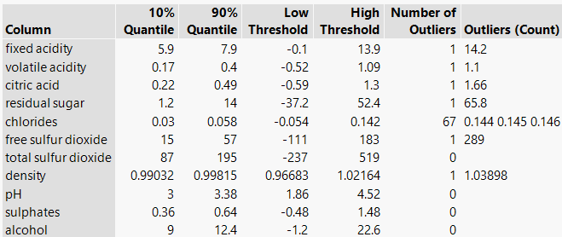
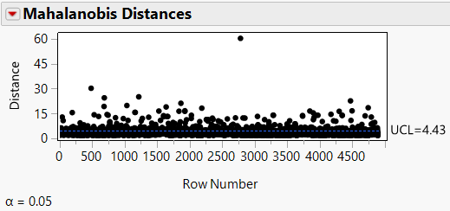
DATA DESCRIPTION
DATA PREPROCESSING
MODEL COMPARISON
MODEL INTERPRETION
RECOMMADATION
DEAL WITH OUTLIERS
Ingredient Content
Alcohol | 8.5% - 11%
Residual Sugar | 0-35g
Free Sulfur Dioxide | Legal Limit 100PPM
Total Sulfur Dioxide | Legal limit 350PPM
Chloride | Legal Limit 607ppm
Volatile Acidity | Legal Limit 1.1g/L
Citric acid | Less than 0.7g/L
Fixed Acid | Less than 11g/L
Outliers are extreme values, Which may influence the performance of Model
Using Quantile Range to detect
Be an expert and consider life Meaning
Quantile Range & Multivariate Robust Of White Wine dataset

Slide 4
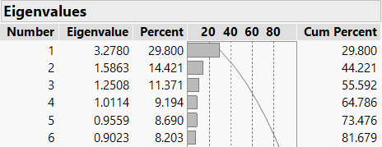
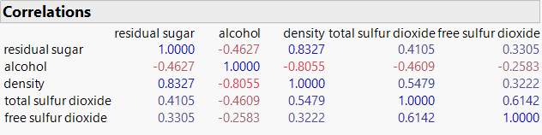
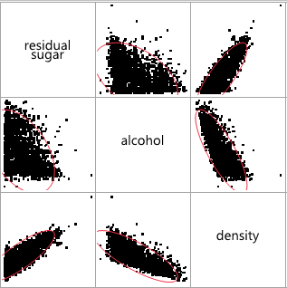
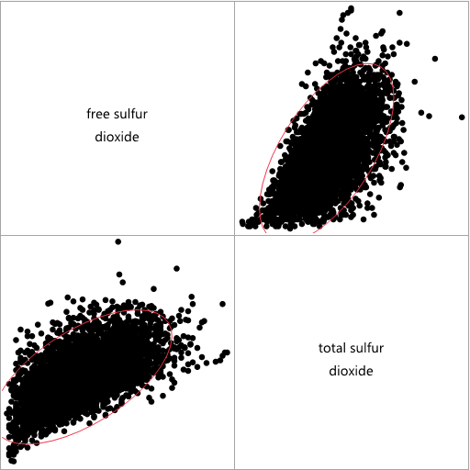
DATA DESCRIPTION
DATA PREPROCESSING
MODEL COMPARISON
MODEL INTERPRETION
RECOMMADATION
DATA REDUCATION
Principal Components Analysis of white wine
Collinearity means that variables may include overlap information. It may increase the complexity of model.
Using Multivariable in JMP to detect
Excluding one of them directly
Using PCA to delete overlap information
Multivariable Analysis of White Wine
Multivariable
Exclude Density — Keep Residual Sugar & Alcohol
Exclude Free Sulphur Dioxide — Keep Total Sulphur Dioxide

Slide 5
DATA DESCRIPTION
DATA PREPROCESSING
MODEL COMPARISON
MODEL INTERPRETION
RECOMMADATION
Logistic Regression
RED WINE
DATA TYPE | Misclassification Rate | Accuracy of 1
Original Data | 27.2% | 75.4%
Transformed Data | 27.2% | 75.4%
Principle Component | 28.5% | 73.6%
WHITE WINE
DATA TYPE | Misclassification Rate | Accuracy of 1
Original Data | 25.2% | 77.3%
Transformed Data | 25.2% | 77.3%
Principle Component | 27.2% | 74.2%
The Logistic Regression of Red Wine has the same result.
The original data and transformed data’s misclassification rate are lower and accuracy of 1 are higher.
The original data and transformed data have same result, since after selecting significant variables, they have the same remaining variables.
Models Comparison
WHITE WINE
Model | Misclassification | Accuracy of 1 | AUC
Logistic Regression | 25.2% | 77.3% | 78.8%
Decision Tree | 25.2% | 81.5% | 77.4%
Boosted Tree | 23.4% | 78.8% | 82.8%
Bootstrap Forest | 24.6% | 75.4% | 82.2%
Neural Network | 24.3% | 78.4% | 81.2%
In White Wine, the misclassification rate of Boosted Tree is much lower, while the accuracy of high of Decision Tree is much higher. For the AUC, Boosted tree is the best Model.
In Red Wine, the misclassification rate of Bootstrap Forest is much lower, , while the the accuracy of high of Neural Network is much higher. For the AUC, boosted tree is the best model.
RED WINE
Model | Misclassification | Accuracy of 1 | AUC
Logistic Regression | 27.2% | 75.4% | 78.6%
Decision Tree | 27.9% | 73.9% | 76.9%
Boosted Tree | 27.5% | 74.7% | 81.8%
Bootstrap Forest | 25.3% | 73.6% | 80.0%
Neural Network | 25.5% | 78.4% | 80.2%
In conclusion, Logistic Regression is chosen as best model, even though the performance of each parameter is not the best.
The parameter is close to that of other models.
The model is simple, and predictors are easy to be interpreted.

Slide 6
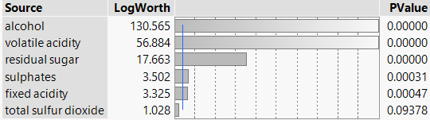
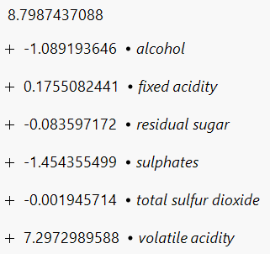
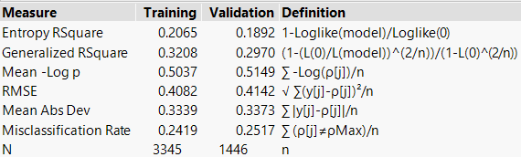
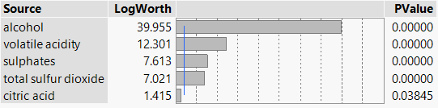
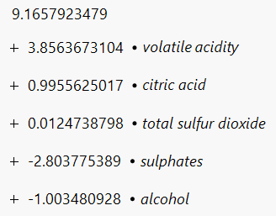
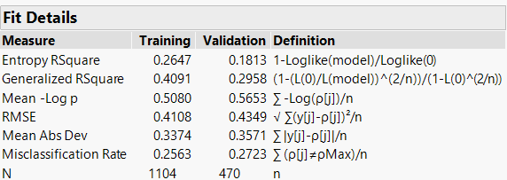
DATA DESCRIPTION
DATA PREPROCESSING
MODEL COMPARISON
MODEL INTERPRETION
RECOMMADATION
WHITE WINE
White Wine
For High Quality:
This is regression for Low Quality!!!
Keep Total Sulphur Dioxide
Even though the p-value of it is larger than 0.05.
The misclassification rate of Total Sulphur Dioxide would increase to 0.2627 if it is deleted.
It plays an important role in real life.
Positive Relationship
Alcohol
Residual Sugar
Sulphates
Total Sulfur Dioxide
Negative Relationship
Fixed Acidity
Volatile Acidity
Red Wine
This is regression for Low Quality!!!
For High Quality:
Five Significant Variables:
Alcohol, Volatile Acidity, Sulphates, Total Sulfur Dioxide and Citric Dioxide.
Don’t need to keep more since the misclassification rate would not change a lot.
Positive Relationship
Alcohol
Sulphates
Negative Relationship
Volatile Acidity
Citric Acid
Total Sulfur Dioxide

Slide 7
DATA DESCRIPTION
DATA PREPROCESSING
MODEL COMPARISON
MODEL INTERPRETION
RECOMMADATION
ACIDITY
RESIDUAL SUGAR
Acids are one of 4 fundamental traits in wine and give wine tart and sour taste.
Acidity adds a sense of vitality and refreshment to the wine and also make the flavor of the wine more prominent.
Acid has an appetizing effect, so you want to have another cup.
In Low levels it adds to the complexity of flavor but in High levels it causes the wine to spoil.
Residual Sugar (or RS) is from natural grape sugars leftover in a wine after the alcoholic fermentation finishes.
It can improve one of 4 fundamental traits in wine, the sweetness..
ALCOHOL
TOTOL SULFUR DIOXIDE AND SULPHATES
Alcohol is also one of 4 fundamental traits.
It can improve glymphatic and it often manifests as a burning sensation in the base of the tongue and in the throat.
Sulfites preserve wine and slow chemical reactions, which cause wine to go bad.
Stop bacteria and yeasts from growing, keeping the fresh taste of the wine.
However, the high sulfur dioxide content will produce an unpleasant smell like a rotten egg, which may cause health problems after drinking.
TIPS FOR CONSUMERS
TIPS FOR WINERY
Color, Alcohol, Smell are good signal for the quality of wine.
Choose the wine with light color . The darker the color, the greater the lever of acidity. But the acidity has negative relationship with quality level.
Smell the cork before buy it. The rotten egg smell means the wine is unhealthy especially for red wine.
Choose the wine with higher Alcohol concentration if you can accept.
White Wine
Red Wine
Manage Volatile Acidity level
Decrease Fixed Acidity
Do not add extra residual sugars
Increase both sulfur dioxide and sulphate.
Increase Alcohol Concentration Within Proper Limit.
Manage Volatile Acidity level
Decrease Citric acidity in red wine.
Do not consider residual sugar
Keep or even reduce total sulfur dioxide
Add more sulphate
Increase Alcohol Concentration Within Proper Limit.
All recommendations apply only to Vinho Verde!!!

Slide 8



Using JMP® To Analyze Wine Quality
Tianhao Zhao
tianhao.zhao@uconn.edu
551-689-1048
Xinyin Miao
xinyin.miao@uconn.edu
571-523-9713
Yongxin Cui
yongxin.cui@uconn.edu
860-5024-375

